Slide 1
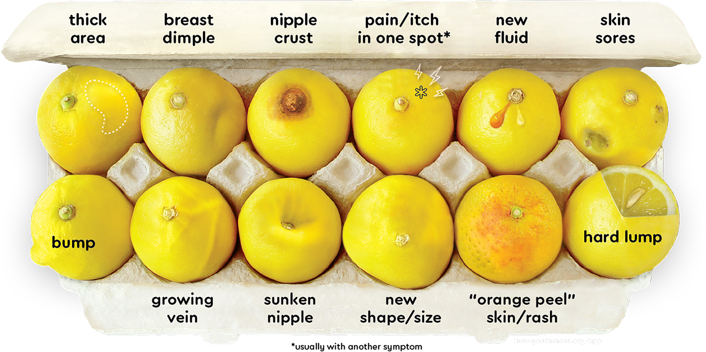

IMPLEMENTING TISSUE HETEROGENEITY IN FINITE ELEMENT BREAST MODELS FOR OPTICAL CANCER DETECTION
Made by: Ryan Engels
Supervisor:
Prof. Dr. Ir. C.W. Hurkmans
Bio-Informatica

Slide 2
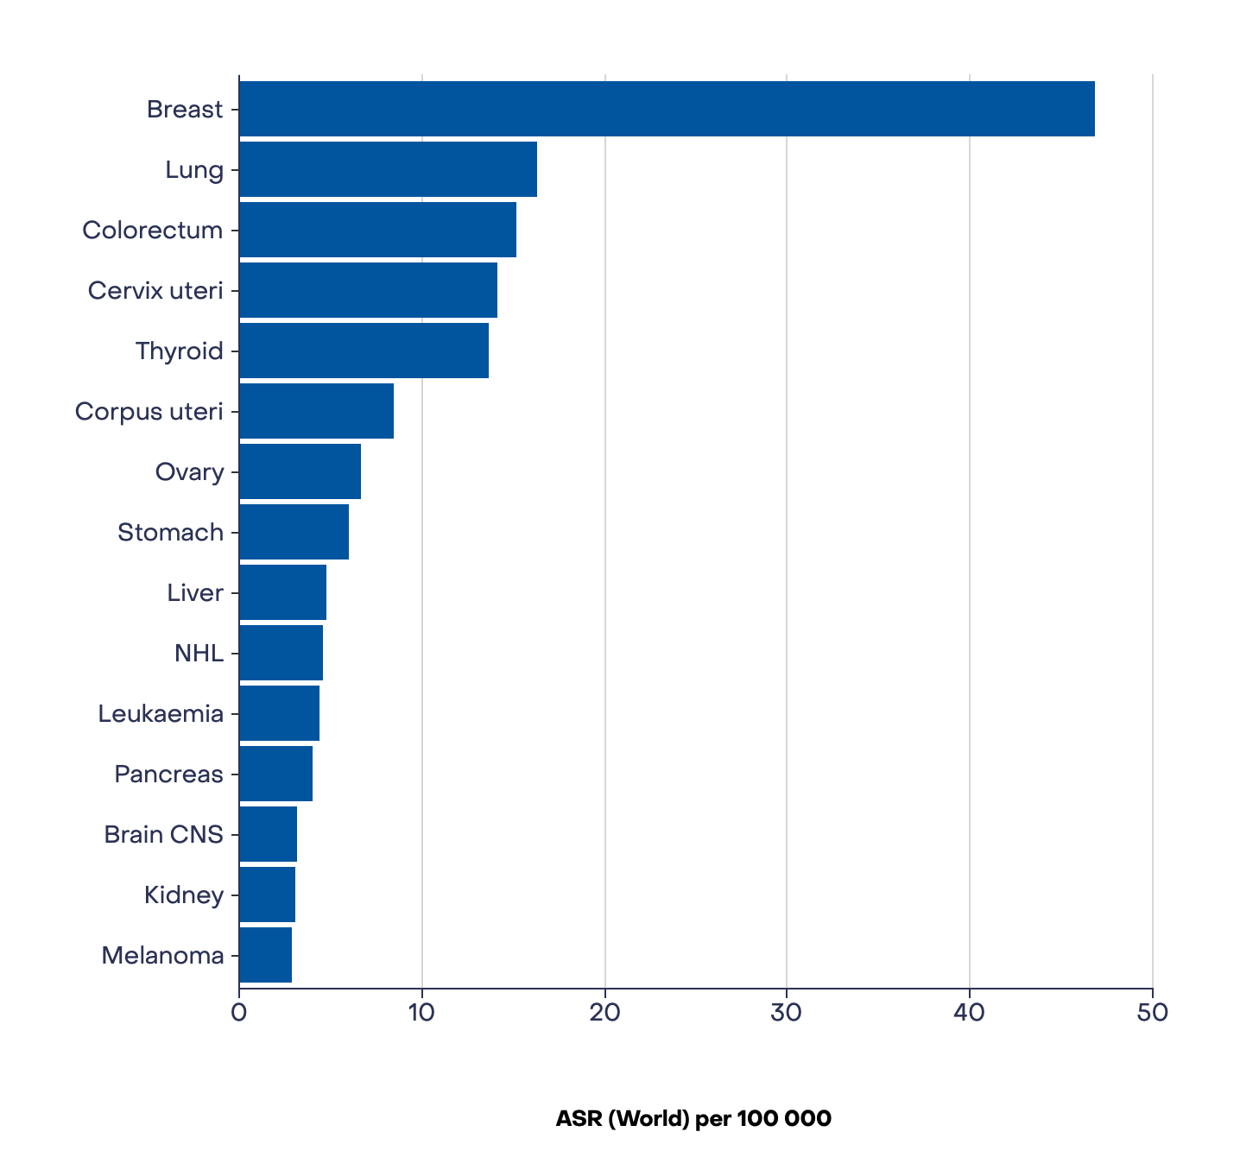
Global challenge
Most common cancer
Early detection
Screening saves lives
Source: Global Cancer Observatory (IARC), Cancer Today, https://gco.iarc.fr/

Slide 3
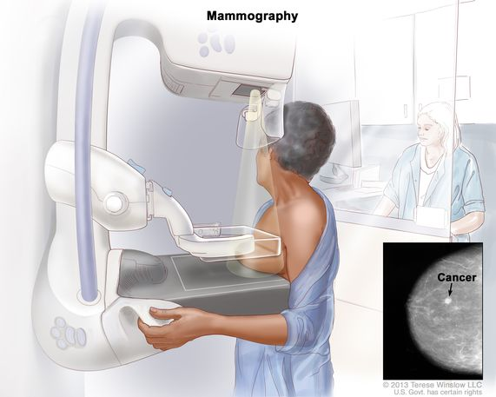
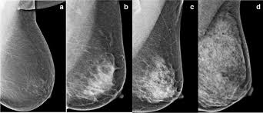
Current screening limitations
X-ray mammography
Reduced sensitivity in dense breast tissue (especially women <40)
3

Slide 4
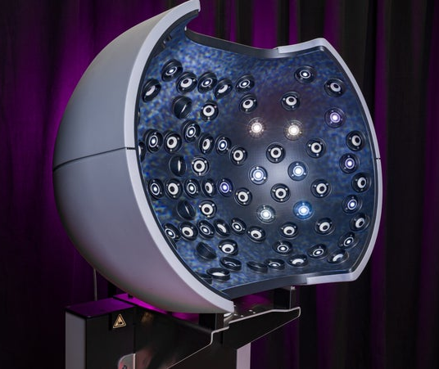
Early warning scan
Multi camera optical imaging system
Radiation free alternative
Exploits biomechanical differences between healthy and cancerous tissue
Source: Early Warning Scan, EarlyWarningScan.nl, https://www.earlywarningscan.nl

Slide 5
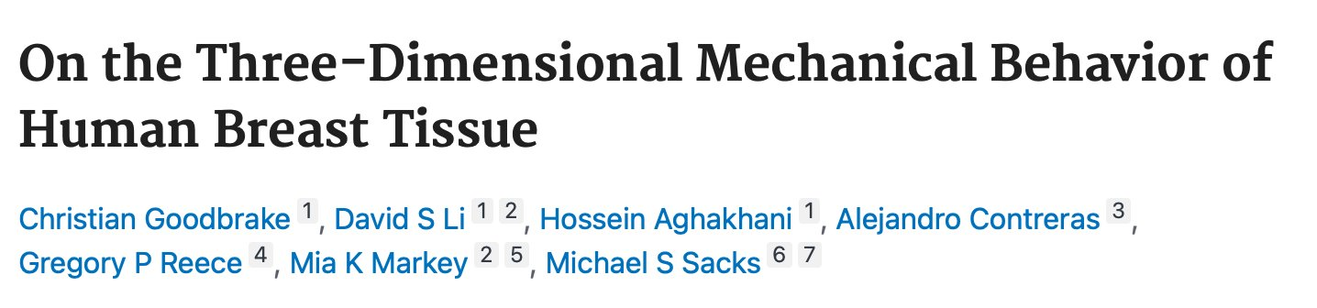
The Reality of Breast Tissue
Tissue heterogeneity in breasts
Glandular tissue 2-3x stiffer than adipose
Gradual transitions
​

Slide 6
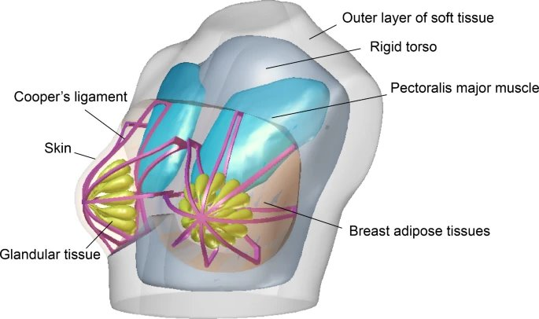
Why Finite Element Models
Predict tissue deformation
Generate systematic data
Simulate soft tissue mechanics
Test different material properties
Source: Chen et al., Sci Rep, 2025. DOI: https://doi.org/10.1038/s41598-024-83598-8

Slide 7
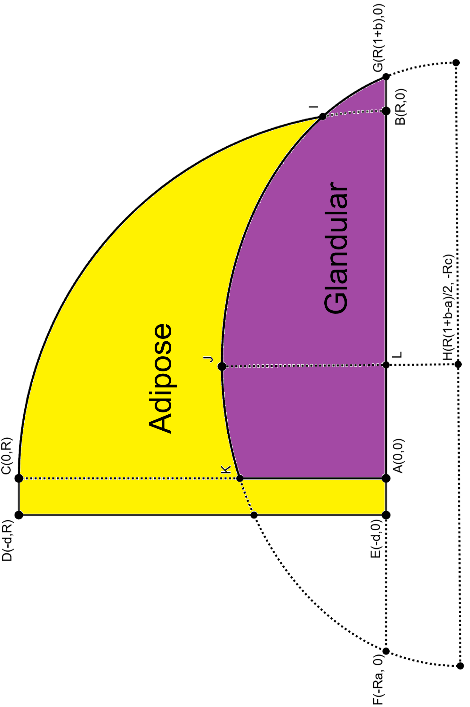
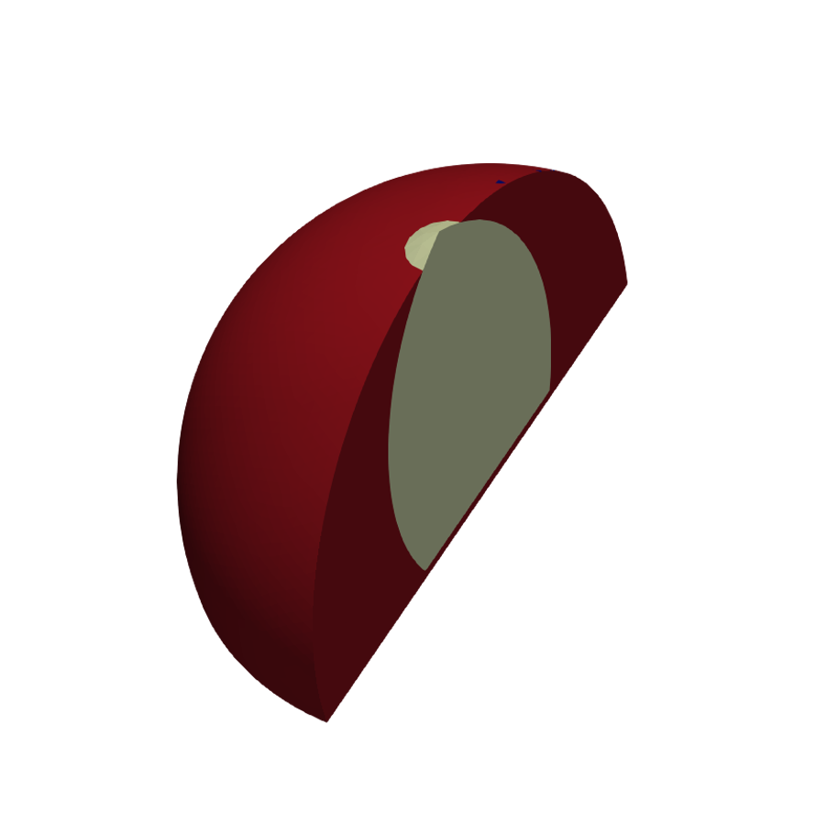
Current Finite element model
Oversimplified homogeneous models
Proof-of-concept
Literature based values

Slide 8
Research question
Hoe beïnvloedt het implementeren van weefselheterogeniteit en de lobulaire structuur van klierweefsel de biomechanische respons van het borstmodel tijdens gesimuleerde beweging? En hoe komt deze verandering tot uiting in oppervlakte displacement patronen?

Slide 9
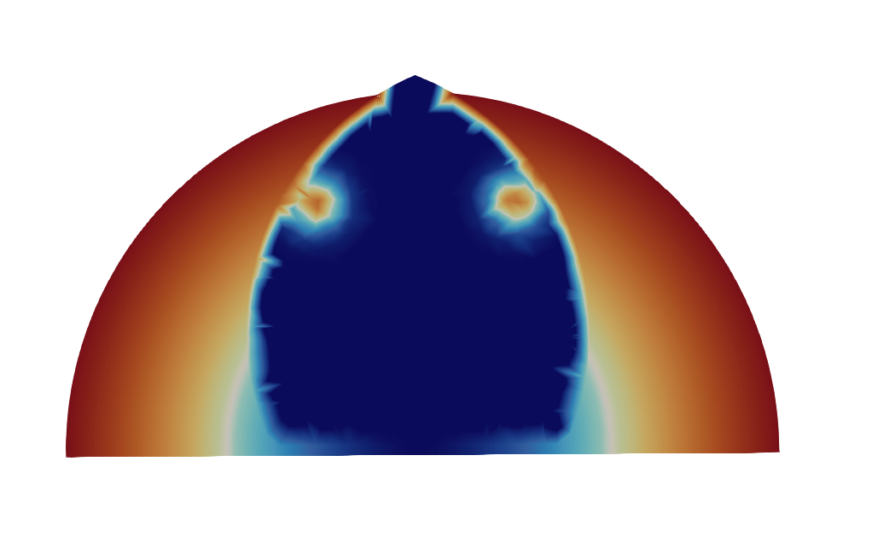
Model implementation
Radial density and stiffness gradients
Lobular structures in glandular tissue
Eight model variants analysed

Slide 10
Parameters
Model | Adipose ρ (kg/m³) | Adipose c₁ (Pa) | Adipose c₂ (Pa) | Glandular ρ (kg/m³) | Glandular c₁ (Pa) | Glandular c₂ (Pa) | Bulk Modulus K (Pa)
Baseline | 911 | 109 | 106 | 1041 | 230 | 195 | 425,000
Radial gradient (density only) | 911 + a=50 | 109 | 106 | 911 | 230 | 195 | 425,000
Radial gradient (coef only) | 911 | 109 + a=30 | 106 + a=25 | 911 | 230 | 195 | 425,000
Lobular (Glandular only) | 911 | 109 | 106 | 911 + 6 lob a=35 | 230 + 6 lob a=70 | 195 + 6 lob a=55 | 425,000
Full model (Radial + Lobular) | 911 + a=50 | 109 + a=30 | 106 + a=25 | 911 + 6 lob a=35 | 230 + 6 lob a=70 | 195 + 6 lob a=55 | 425,000

Slide 11
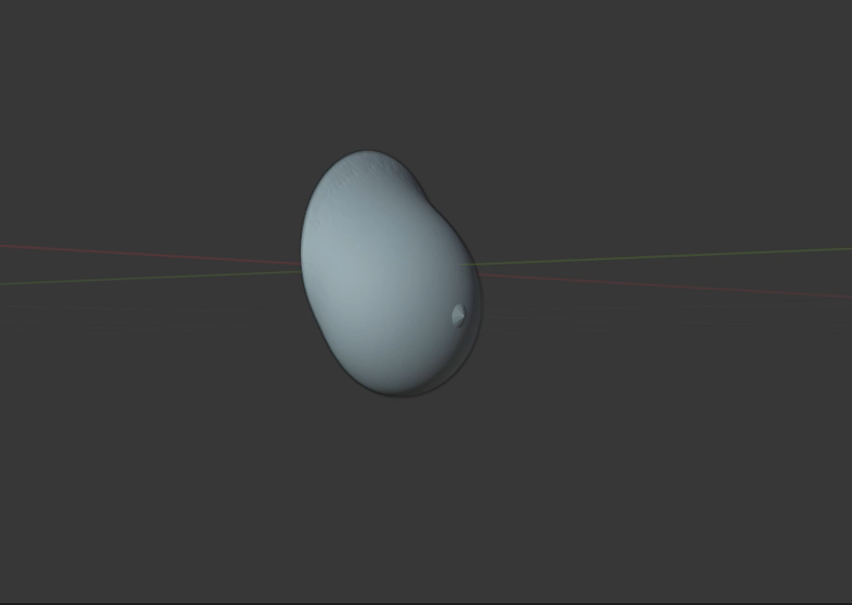
Results
Stiffness gradient: 13% reduction (14.0 mm → 12.2 mm)
Density gradient: 2% reduction (14.0 mm → 13.7 mm)
Lobular model: 9% increase (14.0 mm → 15.3 mm)
Full Model: 4% reduction (14.0 mm → 13.4 mm)

Slide 12
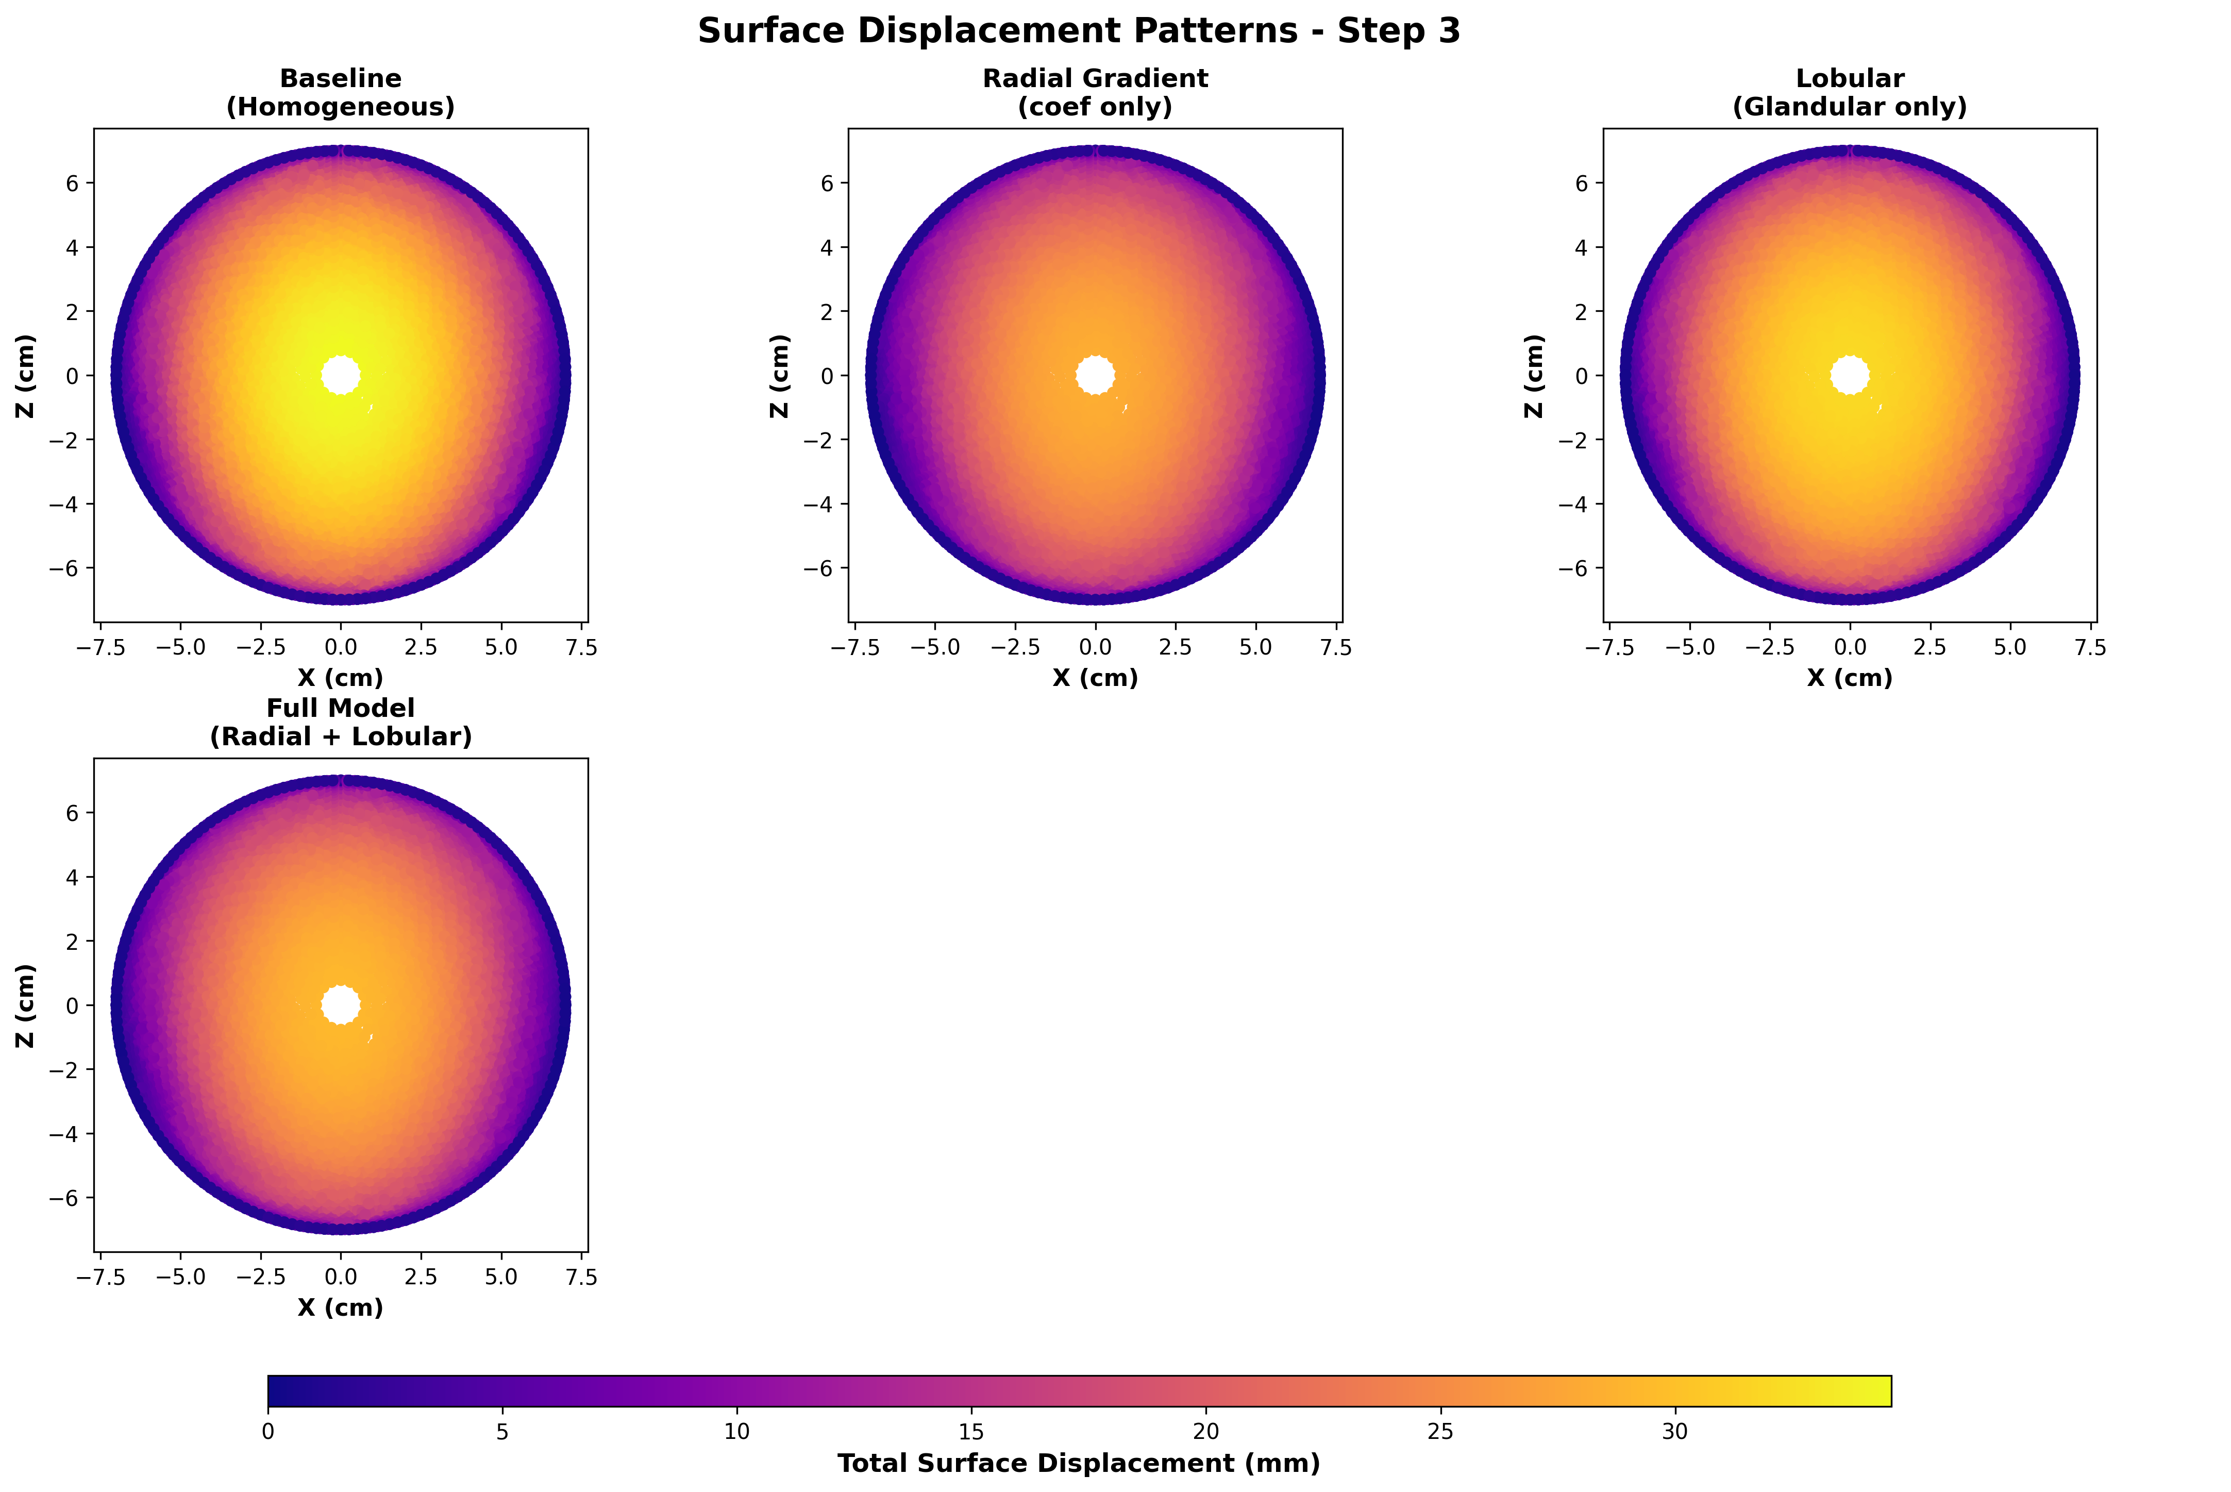
Results

Slide 13
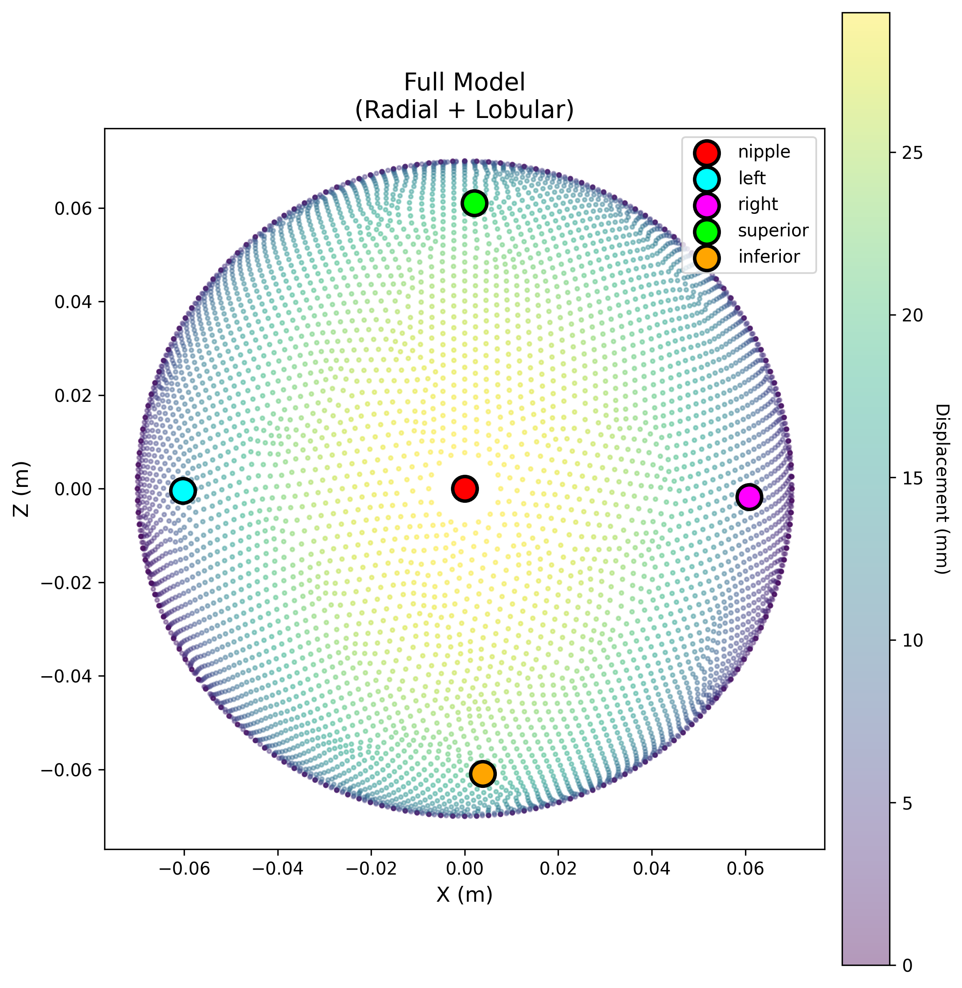
Results
Nipple region: 89% displacement increase with stiffness gradients (1.52 mm → 2.88 mm) density gradient (1.52 mm → 2.11 mm)
Lateral positions: consistent across models
Superior-inferior displacements
Baseline: 4.75 mm
Gradient density: 4.79 mm
Gradient stiffness: 5.77 mm

Slide 14
Limitations
Idealized geometry
Literature-based parameters
FEBio
Data starting point

Slide 15
conclusion
Heterogeneity fundamentally alters biomechanical response
Surface displacement changes are measurable and realistic
Stiffness variations more important than density
Model needs improvements for AI training data generation
Supports radiation free cancer detection development

Slide 16
Future directions
Free form geometry
Patient specific geometries from medical imaging
Validation with clinical data
Cooper's ligament structures
Tumour

Slide 17

Questions?

Slide 18
Model | Nipple (mm) | Left (mm) | Right (mm) | Superior (mm) | Inferior (mm)
Baseline | 1.52 | 9.74 | 9.81 | 6.46 | 4.75
Radial (ρ) | 2.11 | 9.79 | 9.84 | 6.43 | 4.79
Radial (c) | 2.88 | 9.77 | 9.74 | 6.76 | 5.77
Lobular | 2.31 | 9.68 | 9.71 | 6.39 | 4.97
Full Model | 2.72 | 9.69 | 9.68 | 6.64 | 5.52
Adipose ρ | 2.28 | 9.67 | 9.70 | 6.39 | 4.97
Glandular ρ | 0.96 | 8.92 | 9.05 | 5.95 | 3.64
Complete Model | 1.47 | 8.88 | 8.97 | 6.44 | 3.60

Slide 19
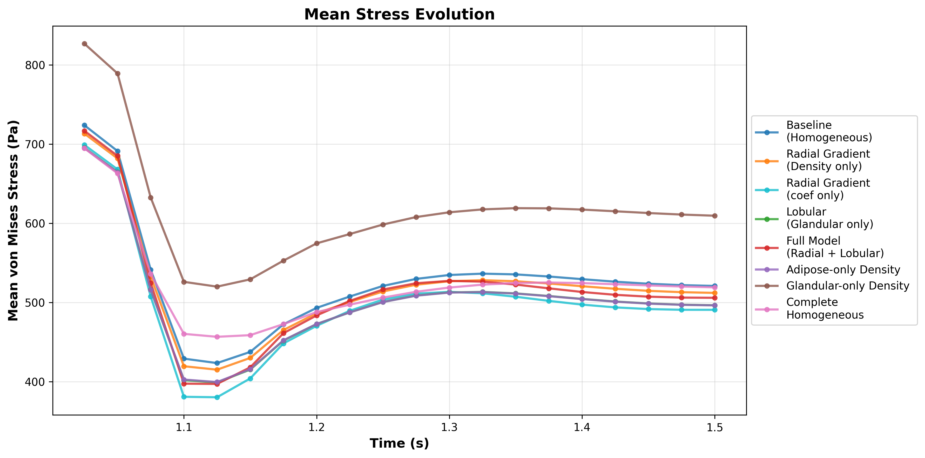

Slide 20
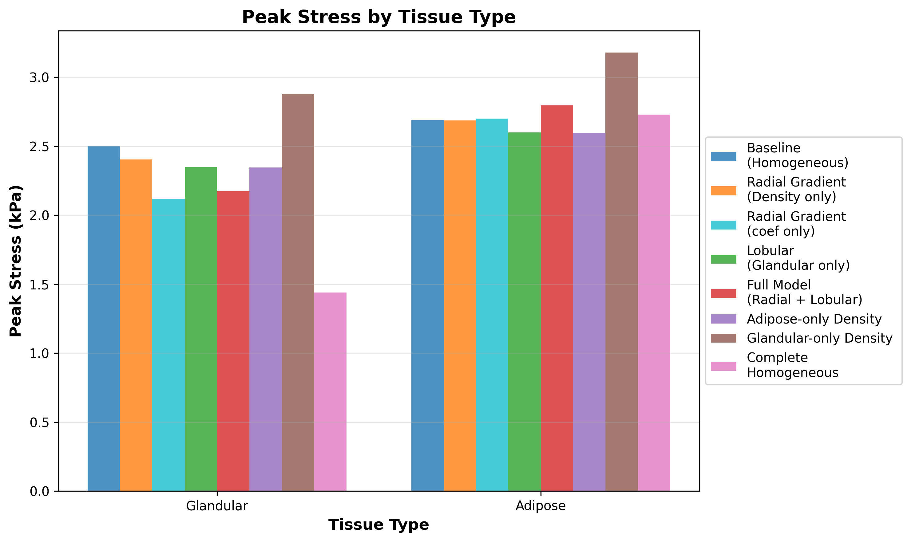

Slide 21
